Slide 1
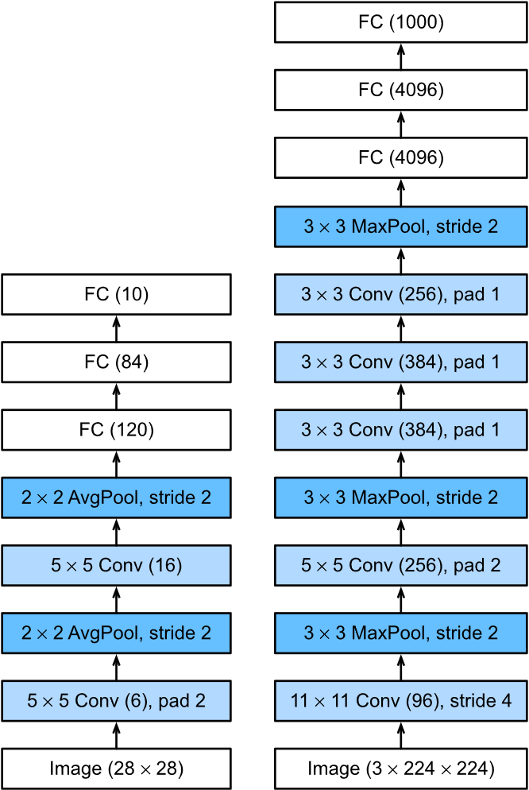
AlexNet
Introduction to Computer Vision
Cordonnier Xavier
2025/11/12

Slide 2
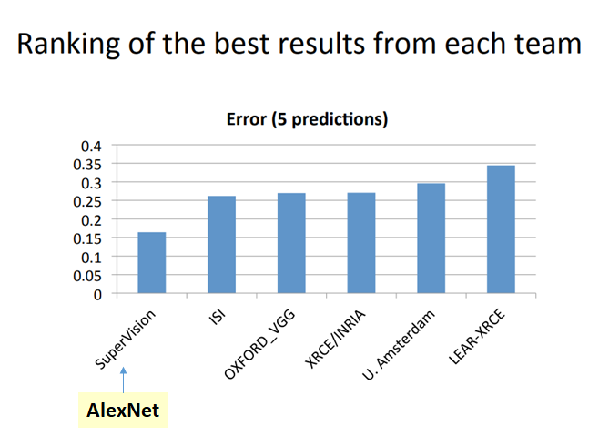
Context
New step in CNN usage
Prove the potential of CNN over supervise methods
Introduction of new solutions
Use of 2 GPU as processing unit
Win the 2012 ILSVRC

Slide 3
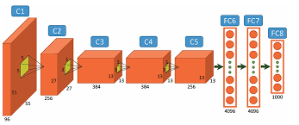
Technical description
8 layers network
Max pooling
ReLu and SoftMax activation function
Image augmentation technics
LRN and dropout normalization

Slide 4
Technical description
Feature map / Image size | Filter size | padding | Stride | pooling | Normalization
224*224*3 | 11*11 | 0 | 4 | Yes | LRN
27*27*256 | 5*5 | 0 | 1 | Yes | LRN
13*13*384 | 3*3 | 1 | 1 | No | No
13*13*384 | 3*3 | 1 | 1 | No | No
13*13*256 | 3*3 | 1 | 1 | Yes | No

Slide 5
Technical description
Fully connected layer number | Number of neurons | Normalization
1 | 4096 | Dropout 50%
2 | 4096 | Dropout 50%
3 | 1000 | No
Returns a 2d vector with the score for each of the 1000 classes

Slide 6
Technical description
Feature map | Pooling size | padding | Stride | Size after polling
55*55*96 | 3*3 | 0 | 2 | 27*27*96
27*27*256 | 3*3 | 0 | 2 | 13*13*256
13*13*256 | 3*3 | 0 | 2 | 6*6*256
Pooling windows are overlapping :

Slide 7
Observations
The last Convolutional layer :
6*6*256 = 9 216 and not 4 096
Around 60 millions parameters total

